Slide 1
IT initiatives that deliver.
IT and project consulting from Eschborn – since 2013
Company presentation · dip-consulting.de

Slide 2
Making digital value a reality
WHO WE ARE
dip is a management consultancy based in Eschborn. Since 2013, our core team has combined subject-matter knowledge, technical expertise and methodological skills – backed by a proven network of partners. Our goal: lasting value for our clients.
60+
10+
PROJECTS
INDUSTRIES
We support projects from the first idea to the last milestone – mainly in financial services, insurance, pharmaceuticals and chemicals, but in many other industries as well. Our focus areas: transformation, migration, cloud, IT service management, process consulting, compliance, security and business analysis. On request, we take on project management as well – traditional or agile.
2013
Eschborn
FOUNDED
HEADQUARTERS

Slide 3
What we stand for
OUR VALUES
01
02
03
More value from IT and processes
Understanding challenges
The outside view
We help our customers generate more value out of their IT and their processes.
We help our customers understand their challenges in IT.
We help our customers see from the outside what they can’t see from the inside.
04
05
06
Sharing knowledge
Effective delivery
Happy customers
We share our knowledge with our customers for their benefit.
We help our customers drive and execute their endeavours in more effective and efficient ways.
We are happy when the customer is happy – and the customer is happy when points 1–5 are covered.

Slide 4
Four topics – one goal: your project lands
SERVICES
01
02
03
04
Strategy & Processes
Transformation & Project Management
Cloud, AI & Agentic Delivery
IT Service Management, Security & Compliance
Setting the strategic direction for tomorrow’s IT, analyzing and optimizing business processes, and preparing requirements so that your organization and IT can respond to them in a targeted way.
Supporting technological change and migrations end to end, and steering projects and programs with agile and traditional methods – from the initial analysis to the handover into operations.
Unlocking the potential of the cloud and using generative AI and agentic workflows with purpose: from platform and architecture to verifiable specifications and an accompanied pilot, with clear human accountability.
Organizing IT services in a standardized and efficient way, and strengthening the security and reliability of your IT systems with suitable security, compliance and governance concepts.
IT Strategy & Enterprise Architecture
Business Process Management
Requirements Management
Transformation & Migration Management
Project & Program Management
Cloud Enablement
AI Enablement & Agentic Architecture
AI-enabled & Agentic Delivery
Behavior-Driven Development & Spec-Driven Development
IT Service Management
IT Security
Compliance & Governance

Slide 5
Strategy & Processes
SERVICES · 01
CONSULTING FIELDS
01
IT Strategy & Enterprise Architecture
Shaping tomorrow’s IT strategically – from today’s system landscapes to the AI-enabled enterprise.
Setting the strategic direction for tomorrow’s IT, analyzing and optimizing business processes, and preparing requirements so that your organization and IT can respond to them in a targeted way.
Business Process Management
Optimization as the key to success
Requirements Management
Responding to business requirements with agility and effectiveness
TYPICAL ROLES Enterprise & solution architecture advisor · AI / digital transformation advisor · Process consultant (BPMN) · Business analyst / requirements engineer · Product owner support

Slide 6
Transformation & Project Management
SERVICES · 02
CONSULTING FIELDS
02
Transformation & Migration Management
Your companion through technological change
Supporting technological change and migrations end to end, and steering projects and programs with agile and traditional methods – from the initial analysis to the handover into operations.
Project & Program Management
Agile and traditional methods for your project landscape
TYPICAL ROLES Project and program manager · PMO / delivery manager · Migration manager

Slide 7
Cloud, AI & Agentic Delivery
SERVICES · 03
CONSULTING FIELDS
03
Cloud Enablement
Unlock the full potential of the cloud for your company
AI Enablement & Agentic Architecture
Unlocking the potential of the cloud and using generative AI and agentic workflows with purpose: from platform and architecture to verifiable specifications and an accompanied pilot, with clear human accountability.
Using generative AI with purpose, securely and economically
AI-enabled & Agentic Delivery
From requirement to pilot, with transparent human accountability
Behavior-Driven Development & Spec-Driven Development
Verifiable specifications as a shared foundation
TYPICAL ROLES Enterprise and cloud architect · AI / digital transformation advisor · Solution & agentic architecture advisor · Business analyst / requirements engineer

Slide 8
IT Service Management, Security & Compliance
SERVICES · 04
CONSULTING FIELDS
04
IT Service Management
A standardized and efficient IT organization
Organizing IT services in a standardized and efficient way, and strengthening the security and reliability of your IT systems with suitable security, compliance and governance concepts.
IT Security
Strengthening the security and reliability of your IT systems
Compliance & Governance
Acting compliantly, minimizing risks
TYPICAL ROLES ITSM/ITIL expert · IT security consultant · Compliance and governance consultant

Slide 9
How we support AI initiatives, in five phases
APPROACH
01
02
03
04
05
Orientation & AI readiness
Solution & agentic architecture
Requirements & specification
Pilot & delivery support
Rollout & enablement
Jointly analyzing business processes, the data and system landscape, use cases, benefits, risks and prerequisites.
Designing the target architecture, decision and approval points, interfaces and tools, permissions, orchestration, and security and quality criteria.
Working out business requirements, domain rules, data flows and user journeys with you as verifiable specifications and BDD scenarios.
Coordinating client and implementation teams, supporting AI-assisted ways of working, evaluating results from a business perspective and steering risks transparently.
Establishing roles, working methods, quality assurance, ongoing evaluation of agents and governance with your teams, and handing over knowledge.
RESULT
Prioritized use cases and business case
RESULT
Architecture and integration concept
RESULT
Specifications, BDD scenarios, acceptance criteria
RESULT
Pilot acceptance criteria and evaluation results
RESULT
Governance and enablement plan

Slide 10
Selected projects from our practice
REFERENCES
IT & TECHNOLOGY
LOGISTICS
RETAIL
Prototype of a cloud-based B2B factoring service platform
Analysis of the group-wide application portfolio
Process management and optimization in Finance & Treasury
Microsoft Azure · AI components · Architecture · Business analysis
Enterprise architecture · IT portfolio management · IT service management · TBM taxonomy
SAP FI · BPMN · Process analysis · Project management
LOGISTICS
BANKING
BANKING
Selection and introduction of enterprise-wide cloud and development platforms
Technology refresh: upgrade and migration programs for expiring vendor support
MS Azure cloud integration: hybrid cloud environment and database migrations
Enterprise architecture · Multi-cloud (AWS, Azure) · Data & AI · IoT
SQL Server · Windows Server · Program management · Software compliance
Microsoft Azure · Hybrid cloud · Migration management · Cloud security
We only name clients with their consent.

Slide 11
Experience that counts
INDUSTRIES & QUALIFICATIONS
INDUSTRIES WE WORK IN
QUALIFICATIONS OF OUR CONSULTANTS
Banking
PMI PMP® – Project Management Professional
ITIL V4 – Managing Professional
CISM – Certified Information Security Manager
Microsoft Certified Azure Solutions Architect Expert
The Open Group – TOGAF 9 Certified
The Open Group – IT4IT™ Foundation
APMG – ISO/IEC 27001 Foundation
COBIT 4.1 / COBIT 5 / COBIT 2019 – Control Objectives for IT
Capability Maturity Model Integration
Microsoft Certified Azure Administrator Associate
FinOps Certified Practitioner
Axelos – PRINCE2 Practitioner
PSM I – Professional Scrum Master I
AWS Certified Cloud Practitioner
DevOps Institute – DevOps Foundation
APMG – ISO/IEC 20000 Foundation
Financial services (e.g. stock exchange)
Insurance
Chemicals
Public sector
Aviation
Logistics
Retail
IT & technology
The following certifications are personal qualifications held by individual dip consultants – they are not certifications of the company.

Slide 12
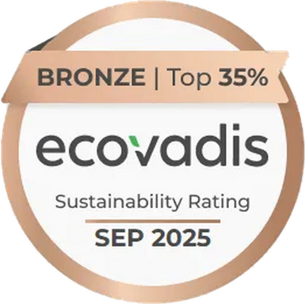
Connected, certified, responsible
MEMBERSHIPS & SUSTAINABILITY
ISACA – Silver membership
Current insights into IT governance, risk management and information security – for secure, future-proof solutions.
Axelos
Home of ITIL and PRINCE2: proven methods for IT service management and project management.
EcoVadis Sustainability Rating: Bronze medal, Top 35% (September 2025)
Our sustainable practices have been assessed by EcoVadis. The rating confirms our commitment to environmentally friendly operations and sustainable business practices – in our internal processes as well as in the solutions we deliver for clients.
PMI
Project management to international standards – for well-structured, successfully delivered projects.

Slide 13
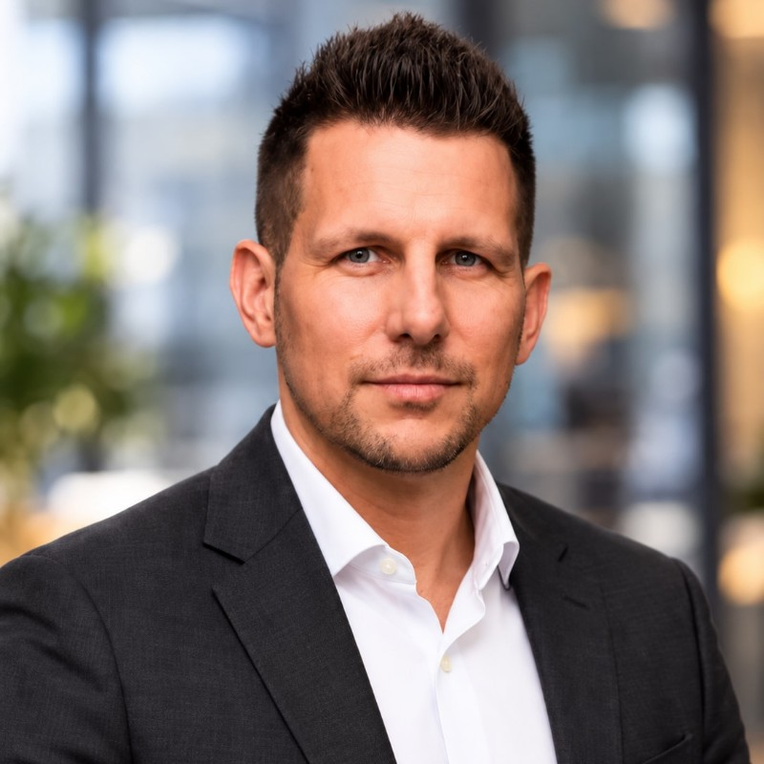
Let's talk about your project.
YOUR CONTACT
Manuel Fernandez
Managing Director · Graduate in Business Informatics
Around 19 years of experience as an IT consultant
Business analysis, enterprise architecture and AI-enabled delivery
Project and transformation management
Certifications include MS Azure Solutions Architect Expert, CISM, ITIL 4 Managing Professional, PMP
+49 6196 58666 20 · info@dip-consulting.de · dip-consulting.de

Slide 14
Let's start a conversation!
DIP Deutsche IT und Projektberatungsgesellschaft mbH
Rahmannstraße 11 · 65760 Eschborn
+49 6196 58666 20
info@dip-consulting.de · dip-consulting.de

